Slide 1

Code Interpreter
Langchain + ChatGPT

Slide 2
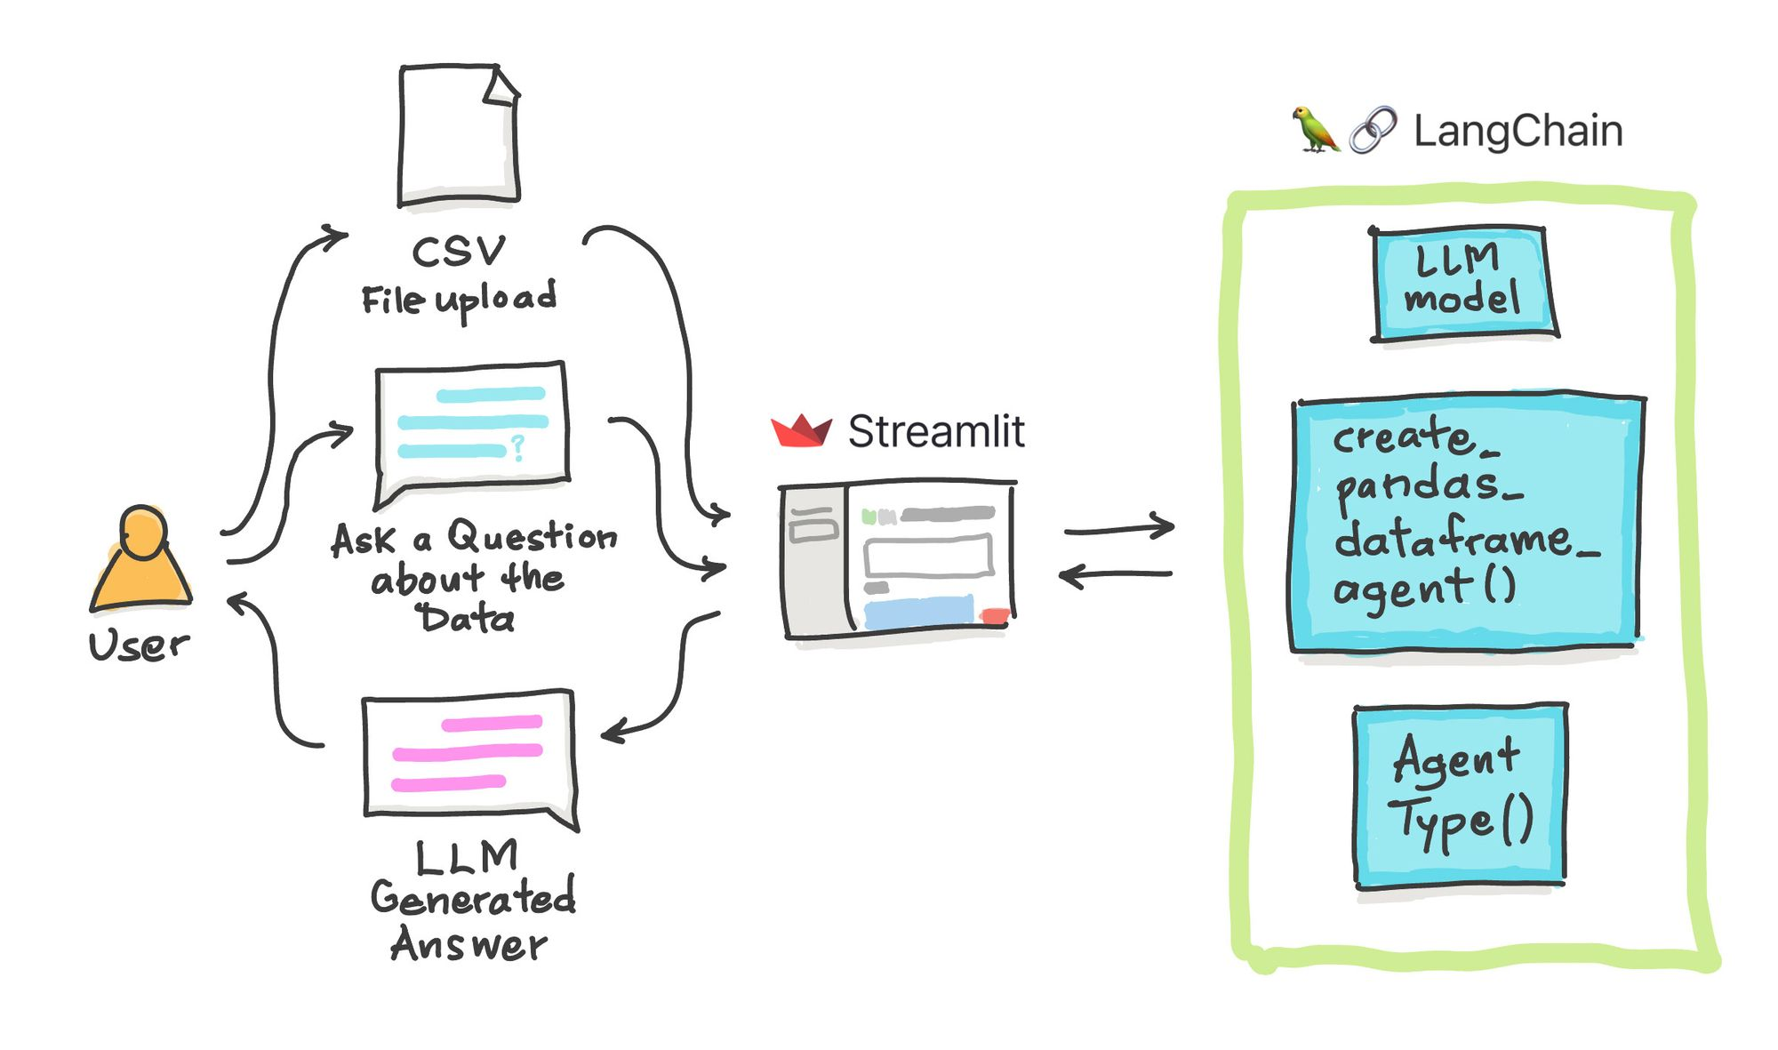
High level architecture
Notes:
https://blog.streamlit.io/langchain-tutorial-5-build-an-ask-the-data-app/

Slide 3
The underlying layer of the 'Code Interpreter API' project utilizes LangChain's Agent tool, which assists large models in using the Code Interpreter. There are two core components inside: LangChain's latest OpenAIFunctionsAgent and a Python code executor.
OpenAIFunctionsAgent is a proxy class provided by LangChain that allows large models to invoke functions and tools.
The author modified this class to support code execution tools and introduced a 'CodeBoxAPI' class as a substitute for LangChain's built-in Python REPL due to its inability to read/write files and losing variables after each execution.
When starting a code interpreter session, the Code Interpreter initiates a mini Jupyter kernel on your device, similar to how Jupyter notebooks operate. CodeBox serves as the underlying Python environment for executing code and receiving outputs, which the proxy can access and utilize to fulfill user requests
code
interpreter
Notes:
https://www.datalearner.com/blog/1051689611560799#Code%20Interpreter%20API%E7%9A%84%E6%8A%80%E6%9C%AF%E5%AE%9E%E7%8E%B0
REPL: A Read-Eval-Print Loop

Slide 4
Feature-rich: Supports dataset analysis, stock chart drawing, image manipulation, internet access, and automatic Python package installation.
Highly interactive: Accepts text and files as input, returning both text and files. It also has session memory, responding based on previous inputs.
Local operation: Apart from the OpenAI API (or possibly soon, OpenOrca or others), everything runs locally.
Easily extendable: Plans to leverage the CodeBox API for scalable production deployment (coming soon).
Key features
https://blog.langchain.dev/code-interpreter-api/

Slide 5
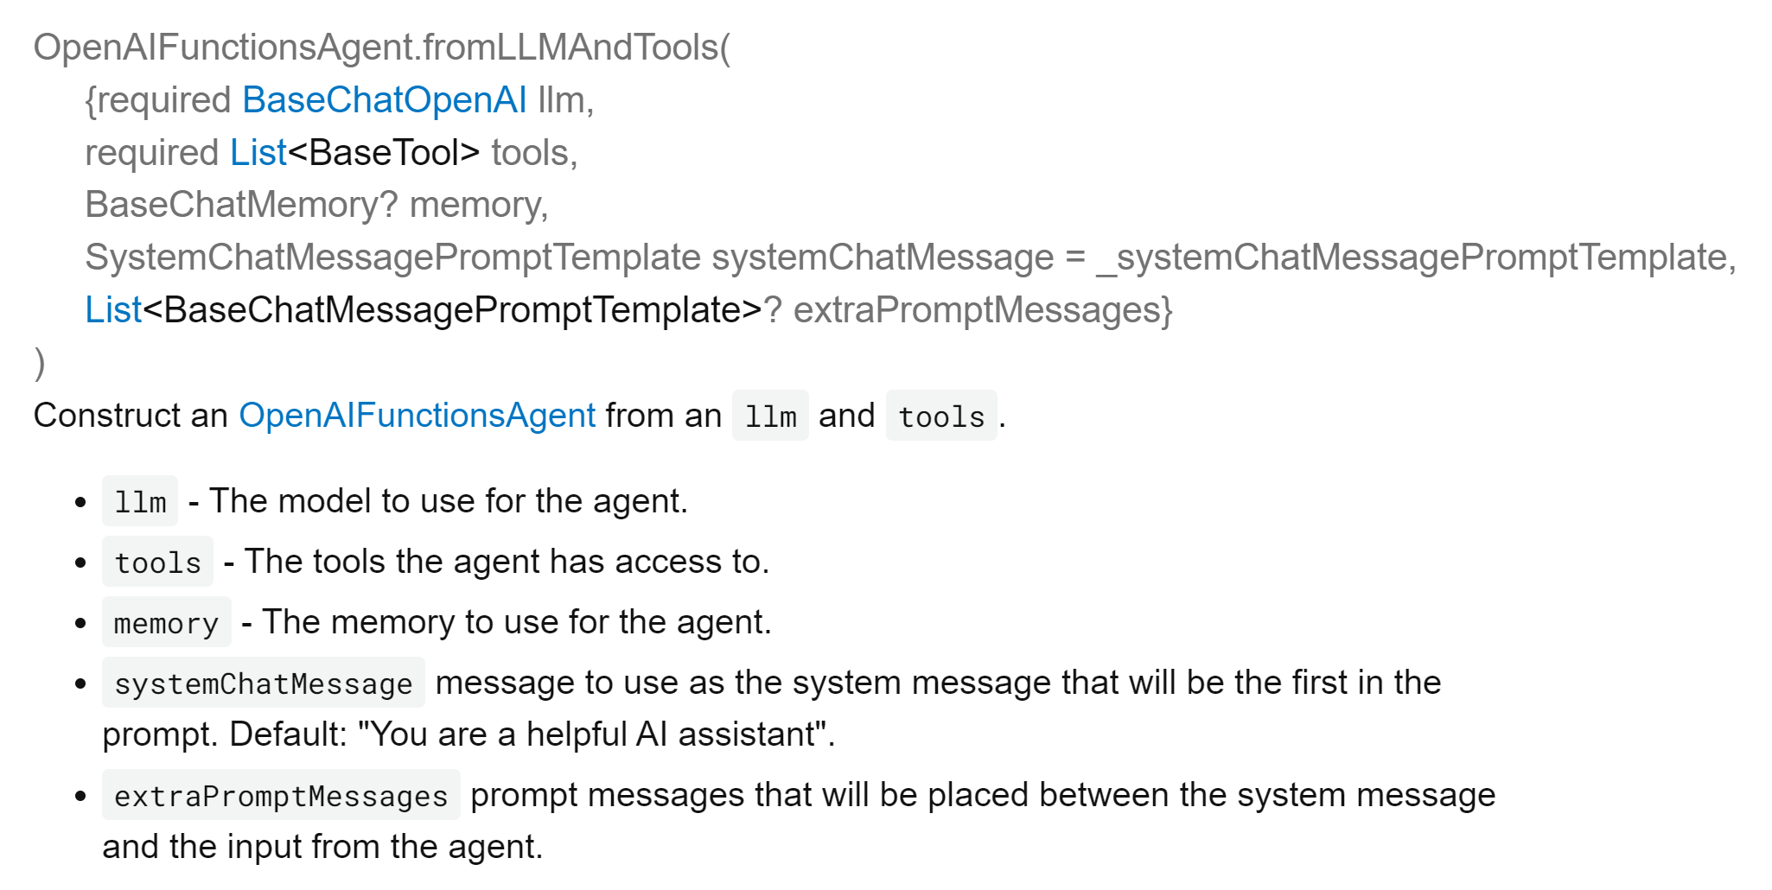
OpenAI Functions Agent
OpenAIFunctionsAgent
llm
tools
memory
Notes:
https://pub.dev/documentation/langchain_openai/latest/langchain_openai/OpenAIFunctionsAgent/OpenAIFunctionsAgent.fromLLMAndTools.html

Slide 6
CodeBox
CodeBox is the simplest cloud infrastructure for your LLM Apps and Services. It allows you to run python code in an isolated/sandboxed environment. Additionally, it provides simple fileIO (and vector database support coming soon).
It is not straightforward to give LangChain Agents access to a Code Execution Environment. There is already Python REPL but this does not allow for FileIO and it also forgets variables after every run.
When starting a Code Interpreter Session it creates a small Jupyter kernel on your device similar to how Jupyter notebooks work. A CodeBox is the underlying Python execution env where the agent can run code and receive its outputs. A small personal computer the agent has access to and which it can use to serve the user its request.
Notes:
https://github.com/shroominic/codebox-api
REPL: A Read-Eval-Print Loop

Slide 7
Make CodeBox production-ready, enabling developers to create public apps as it allows for easy scaling. Currently, each user requires a small sandboxed execution environment, making it challenging to deploy to production with this API.
Make it available using other LLMs like ClaudeV2 or Llama 2. In time, users may be able to run this API 100% locally and offline on their home PC
Future Improvement

